Slide 1

Introduction
Group member:
Chen Li
Mingyu Chen
Kewei SHu
http://www.wp-tech.net/wptech/wp-content/uploads/2016/07/JQuery_logo.png
EG
Internet programming
#<number>

Slide 2
Features
Simple syntax for:
      Selecting DOM elements
      Creating simple animations
      Handle events
      …
EG
Internet programming
#<number>

Slide 3
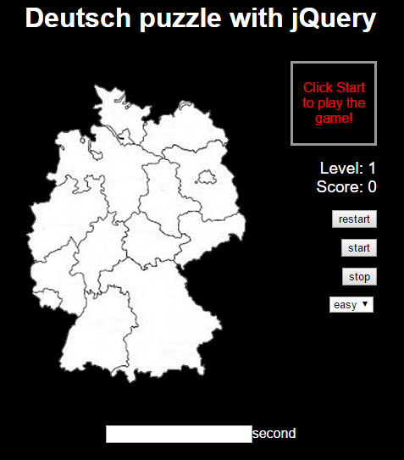
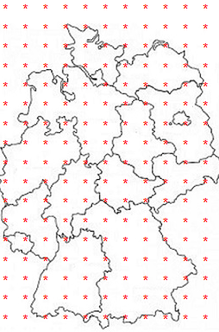
Our application
Use table to record the position of click
EG
Internet programming
#<number>

Slide 4
Structure
class="Schleswig-Holstein"
(2,4) (2,5)
(3,4) (3,5) (3,6) (3,7)
(4,5)(4,6)
class="Baden-Wuerttemberg"
(13,4) (13,5)
(14,4) (14,5) (14,6)
(15,3) (15,4) (15,5)
(16,3) (16,4) (16,5)
(17,3)
EG
Internet programming
#<number>

Slide 5
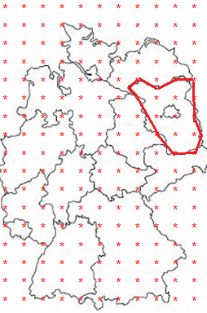
Structure
Setting the points in this area
$(".Brandenburg").click(function(){}
EG
Internet programming
#<number>

